Slide 1
NHIA Collaboration Tool Guide
Section 6.2 – How to Collaborate Effectively

Slide 2
Accessing the Collaboration Tool
Go to the NHIA Collaboration Platform
Log in using: NHIA email address, Password: NhiaPass
Dashboard Features: File sharing, Chat, Document collaboration

Slide 3
Collaborating on Files
Work on documents in Personal Files
Move finalized files to Department/Group Folders
Click Share and select team members
Use Comments to suggest or discuss changes

Slide 4
Conversations & Channels
Access via the Talk feature
Join public channels (e.g., NHIA Forum, Department chats)
Start private conversations by searching for a colleague’s name

Slide 5
Viewing Shared Files
Click the File icon
Select Shares from dropdown
View shared files (to/from you)
Manage access or permissions

Slide 6
Sorting Files
Use sorting icon in file management
Sort by: Name, Size, Modification date
Choose Ascending or Descending order

Slide 7
Creating Chat Groups
Click Talk icon
Select Create a New Conversation
Enter group name & description
Add participants and click Create Conversation

Slide 8
Managing Group Moderators
Go to Participants Page
Click three-dot menu next to a participant’s name
Select Promote to Moderator to give admin rights

Slide 9
Thank You
Contact IT for help
Stay collaborative, stay productive!

Slide 10
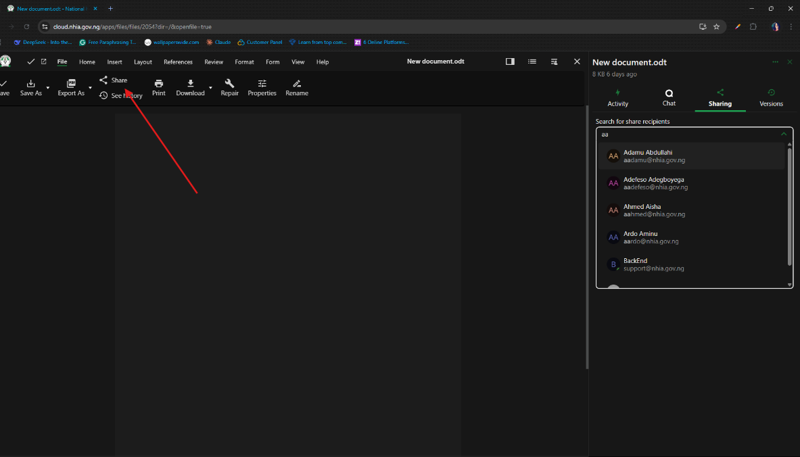

Slide 11
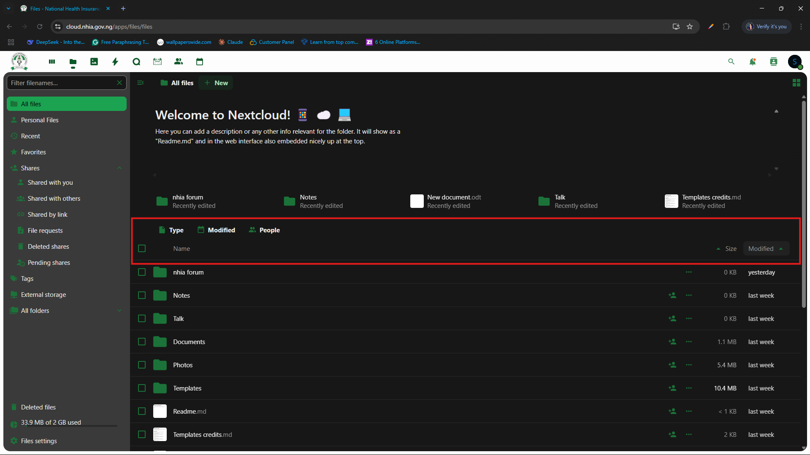

Slide 12
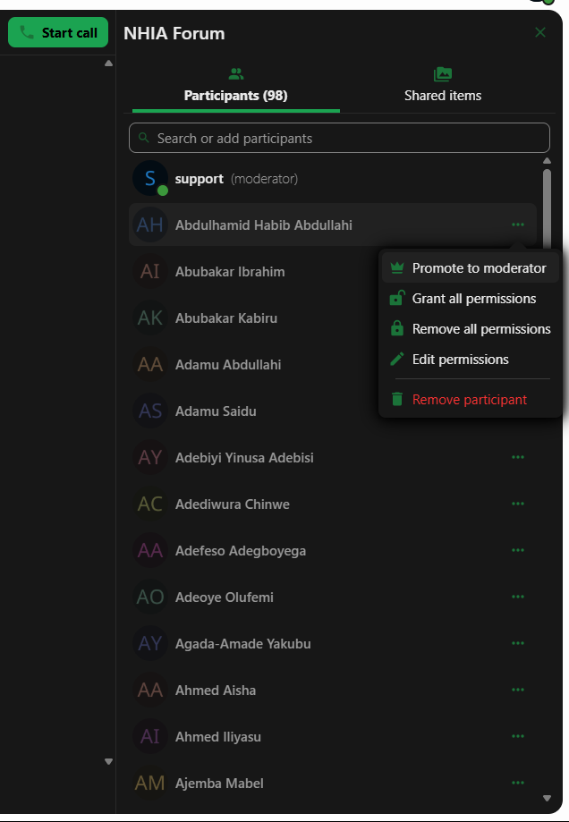

Slide 13
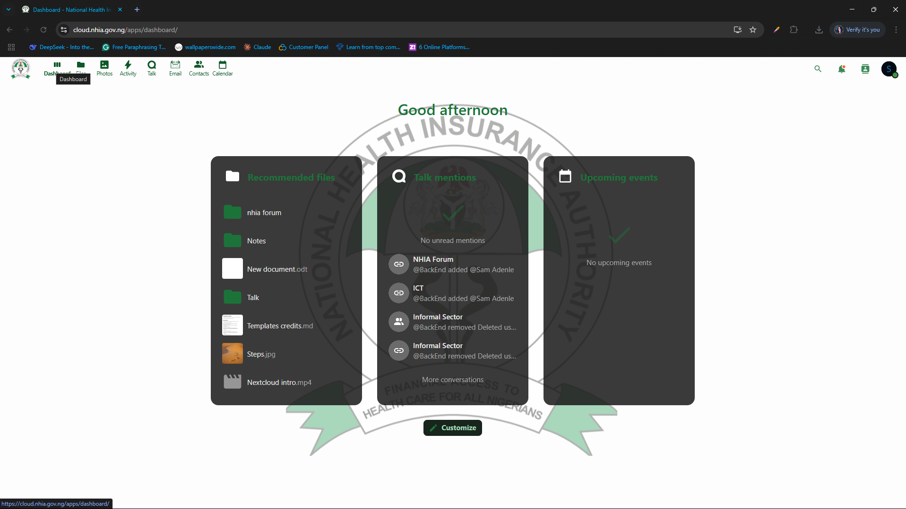

Slide 14
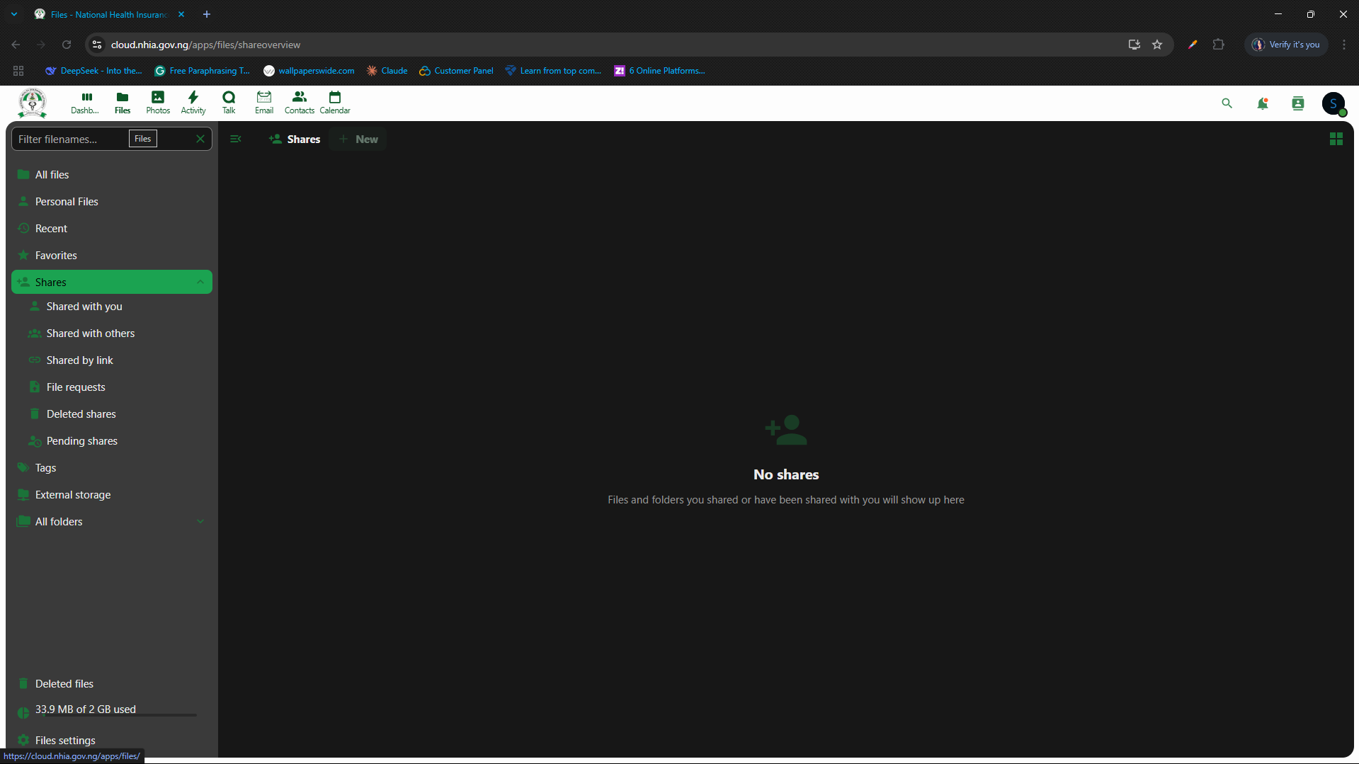

Slide 15
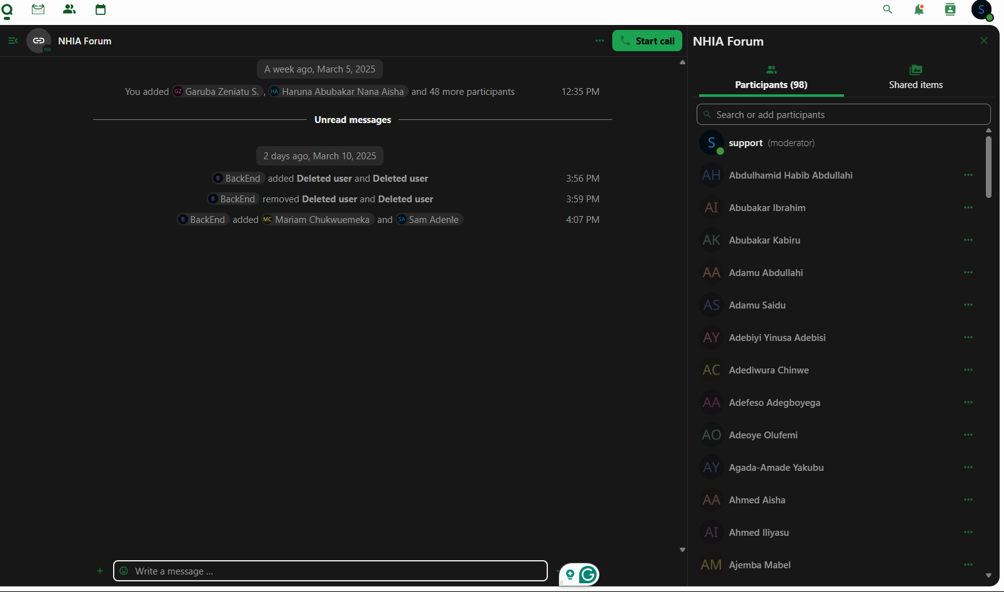

Slide 16
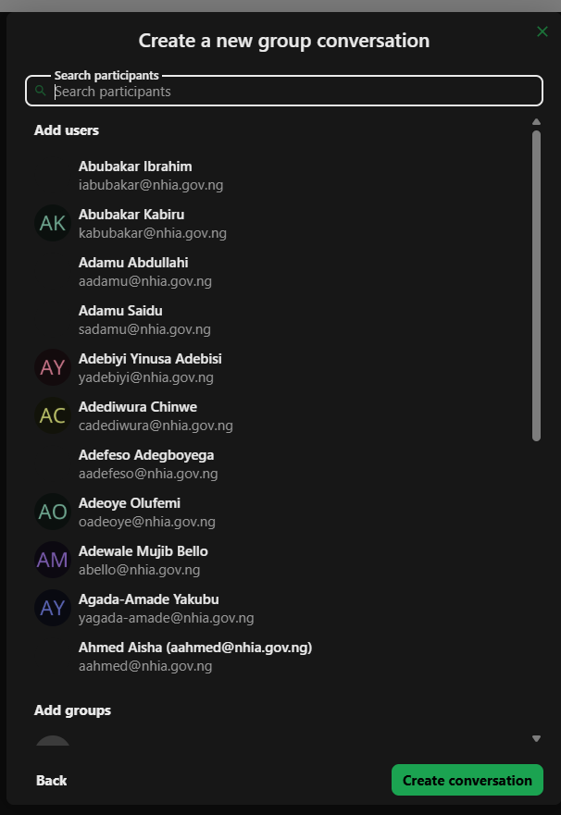

Slide 17
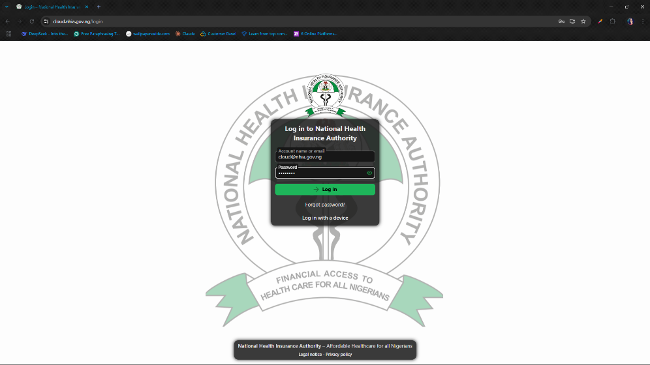

Slide 18
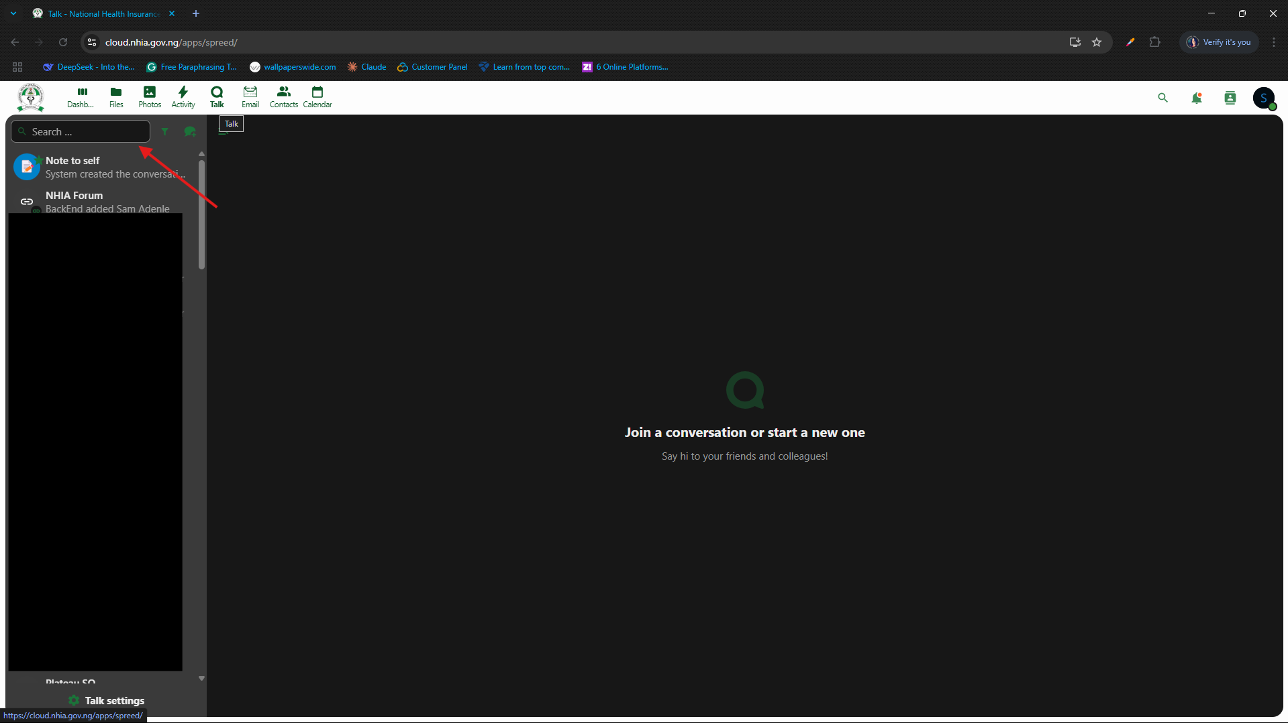

Slide 19
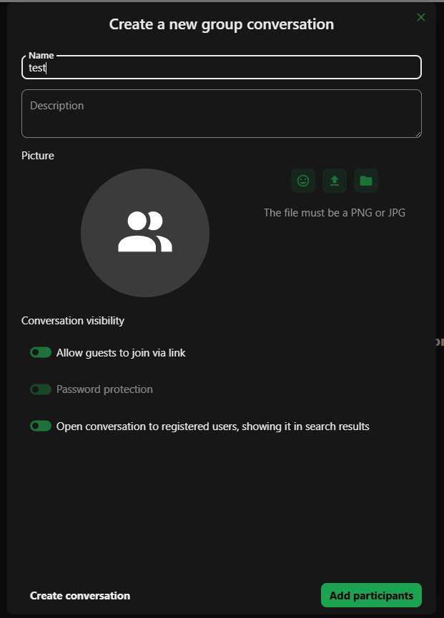

Slide 20
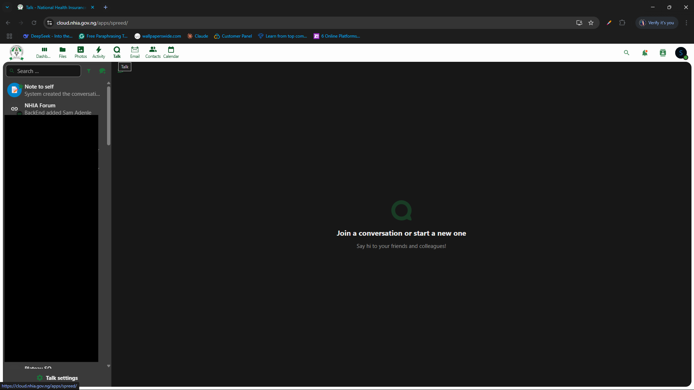

Slide 21
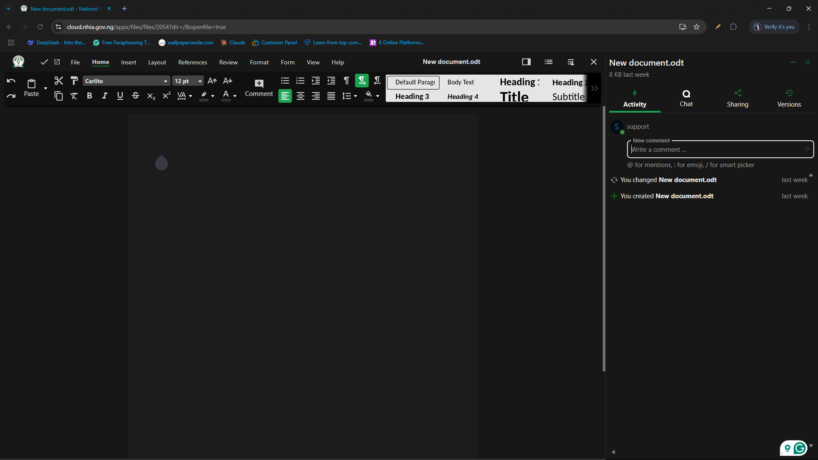

Slide 22
